Slide 1
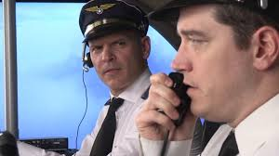
VFR Communications (Non-towered Airports)
Ver 1.2

Slide 2

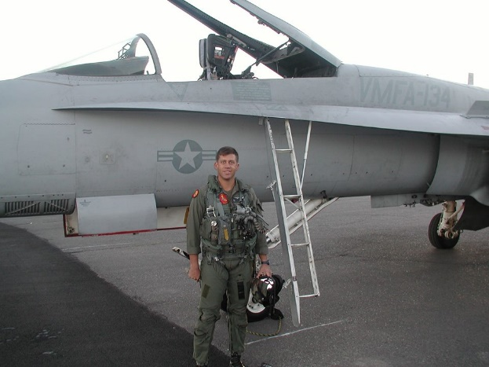
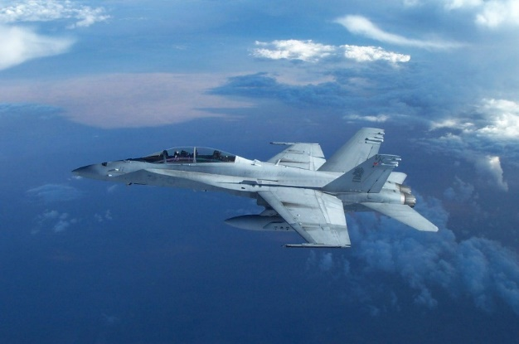
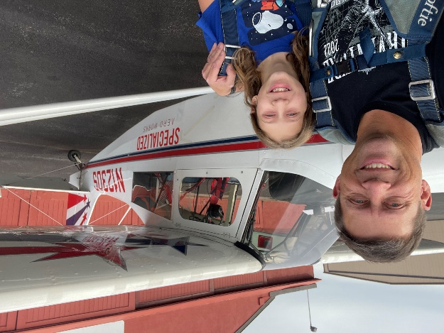
Mike “Cuckoo” Kloch
CEO/Chief Instructor Pilot for Specialized Aero Works
2 x Master CFI - Aerobatic
2 x NAFI Master CFI; CFII, MEI
Contract Test Pilot/Instructor
FAA Safety Team (FAAST) Representative
Former Epic aircraft Pilot/Instructor (contractor now)
Former Chief Airplane instructor at Leading Edge
Contract pilot for Elite Pilot services (Evolution)
Former Advanced Flight Dynamics Chief Instructor Pilot
Former Air Ambulance Captain
Former Marine Corps F/A-18 pilot
School trained Aviation Safety Officer (NPS)
Former USMC Reserve F/A-18 Standardization Officer
B.S. degree from OSU, 2 Aviation Degrees from COCC
Former part-time aviation instructor at COCC
Commercial & Instrument Helicopter rated

Slide 3
Agenda
The Problem and the Solution
The Goal
Radio Technique
When & Where to Talk
The 7 Deadly Sins of Radio Communications
Communication Format
Words & Phrases to Avoid
Do Nots
Examples of Bad Radio Calls
Other Communications
Teaching Tips
Benefits of Good Radio Work
The Challenge
Notes:
Group participation is desired.

Slide 4
The Problem
Problem
There is an excess of poor radio communications
        Why?
        Lack of literature?
        One of the least emphasized parts of pilot training
        A lack of understanding of the importance of good communications
        Accepting “good enough”
Notes:
-These bad radio calls come from everyone ranging from new pilots in training (PTs) to seasoned professionals. This has been an ongoing problem for many years and its time to stop it.
-Lack of literature? Not really. Although the AIM and other FAA publications do not adequately address communications, there are several other resources (books, papers & safety advisors that discuss communicating). You just have to go look for it.
-Unfortunately, in pilot training radio comms. takes ground instruction and is a less exciting subject for instructors so it tends to get neglected.
-There seems to be a lack of understanding as to how important good communications are. There have been many mishaps where communications was a primary or contributing factor.
-”Good enough” should not be acceptable since good communications will mean a higher level of safety.

Slide 5
the solution
Solution
Learn what makes good radio communications and practice!
Think about how you sound to the others receiving your calls. Will your call be useful to anyone?
Learn/Teach correct comms. from the beginning and accept nothing less!
Notes:
If everyone here practices outstanding communications and teaches it as well, then that becomes a very large group of pilots with good communication skills and then they (hopefully) pass it on, and so forth.

Slide 6
Why is this important
Why do we talk on the radio at a non-towered airport?
-
SAFETY!!
Notes:
-Safety is the root reason we talk on the radio.
-Listen to how ATC talks. They have specific & strict requirements on what & how they talk. Most controllers sound good on the radio. A large percentage of pilot do not!

Slide 7
The goal
Good radio transmissions are timely, precise, concise and disciplined.
Poor radio transmissions are slow (or late, or early), sloppy, long-winded and disorganized, filled with pauses and extraneous verbiage. Good radio work is the hallmark of a proficient, intelligent professional pilot.
Every pilot’s goal must be to convey the relevant information needed in a short period of time with the fewest number of words possible.
Notes:
-Precise does not get overly accurate on distances, heading, etc. Distance to within ½-1 mile is accurate enough. If you spend too much time sorting out your distance to the tenth of a mile you will be gone from that position by the time you call it.
-You can be a low flight-time pilot that sounds like a salty professional if you work at it.
-Short, useful calls are critical when the frequency is clobbered with calls due to multiple aircraft in the area.

Slide 8
Precise, Concise and Standardized
Rule number one of aviation radio:
Be precise and concise.
Rule number two of aviation radio:
Follow the standard sequence.
Notes:
Eliminate all unnecessary words; get to the point. Say what needs to be said –– no more, no less –– and then unkey the mic to let other people talk. Use only the essential words, eliminating extraneous verbiage. And use only the right words; remember that words have very specific legal meanings in the world of aviation radio.

Slide 9
Radio calls
Who you are talking to
Who you are
Where you are
What you want to do
Only 50% of what you say is heard
  >The longer you talk, the less is heard

Slide 10
Radio technique
Make sure the radio is audible
Make sure that all microphone jacks are completely plugged in.
If the aircraft you are flying is equipped with an audio panel, make sure you know how to use it.
Place the microphone close to your lips, perhaps even touching them.
Listen before you transmit, especially if you have just changed frequencies.
Think before you transmit!!
Notes:
4. Unfortunately a common problem which makes for weak transmissions that are difficult to hear/understand.
6. Think about what you want to say before you key the mic, and then say it clearly and confidently, without pauses or hesitation. Then unkey the mic and let other people talk.

Slide 11
Radio technique (Cont.)
Speak clearly at a moderate pace with enough VOLUME to be heard. Sound confident!
If you don’t receive an immediate reply to your transmission, be patient.
Be alert to the sounds or the lack of sounds in your receiver.
Press the push to talk (PTT) button before speaking.
Practice proper (and efficient) call sign use.
Notes:
7. Saying three words slowly and clearly is much better than saying twelve words very fast when exactly the same meaning can be conveyed!
9. Check your volume, recheck your frequency, and make sure that your microphone is not stuck in the transmit position. Frequency blockage can, and has, occurred for extended periods of time due to unintentional transmitter operation. This type of interference is commonly referred to as a “stuck mike.”
-Be sure to not hold down the Push to talk button longer than needed. Some people forget to let go after talking!
10. Always use your full aircraft call sign when making the initial contact with a controller or FSS specialist. At non-towed airports no one really cares about your call sign (aircraft plus tail #). Why not abbreviate it to the last 3 digits, example: from “Skyhawk 123AB” to “Skyhawk 3AB”. Or you can use type & color, e.g. “Yellow Decathlon”. Do not use “Cessna XXX”. What kind of Cessna are you? There are many to choose from. Then when you have this habit and call ATC which they have to reply “What kind of Cessna are you?” This leads to extra unnecessary calls.

Slide 12
When & where to talk
According to AIM Table 4-1-1, Summary of Recommended* Communication Procedures, when to make inbound calls
  10 miles out
  Entering downwind
  Base
  Final
  Leaving the runway
*Recommended is not mandatory,
Use sound judgement
Notes:
-Does anyone know what these are?
-Discuss not calling leaving the runway except when visibility is an issue. Examples for good reasons to call are: multiple runways with limited visibility, nighttime, traffic taking off is unable to see the far end of the runway, poor weather conditions. Remember it is the responsibility of the person landing to make sure the runway is clear enough to land. Of course if safety is ever in doubt, go ahead and make the call.
Reasons not to make leaving runway call: Good lighting and landing traffic can easily see the runway is clear. If the frequency is very busy isn’t it better to leave airtime on the freq. for those airborne deconfliction than to state the obvious (clear of the runway)? IF its not obvious, certainly speak up.

Slide 13
When & where to talk
A better list of when to talk inbound?
  10 Miles out
  Any intermediate distance when deconfliction is necessary
  Crossing midfield (optional)
  Entering the 45
  Turning downwind
  Turning Base
  Turning Final
  Leaving the runway (only when prudent)
Notes:
-The intermediate distance call can be at any distance when deemed necessary for deconfliction with a potential threat.
-Crossing midfield: probably good to call if there is traffic on downwind. Some pilots are not great at judging altitude and get nervous with an aircraft passing overhead 500 to 1000 ft. above them.
-Make calls when turning (whenever possible). You are flashing your wings in a turn and easier to see.
-Crosswind calls. Do we really need to make that call? Often no, unless there is a possible traffic conflict such as someone on the 45. then yes, make the call!

Slide 14
When & where to talk
Outbound calls per AIM Table 4-1-1
  Prior to Taxi
  Prior to Takeoff
For example: “Frederick traffic, Bonanza One-Three Charlie departing Runway Two-Three, to the west, Frederick” or “…left closed traffic,” as the case may be.
Notes:
-Consider calling taxi only when prudent (e.g. necessary for deconfliction, night, etc.)
-A good takeoff call will include your intentions after takeoff, e.g. closed traffic, departing direction (left downwind departure southbound or right turn to the east, etc.). After takeoff information especially useful if there is potentially conflicting traffic.

Slide 15
When & where to talk
In addition to the standard inbound & outbound calls, talk anytime there is a deconfliction issue or other hazard.
Intersection Take-offs
  “Bend traffic, helicopter 3AB taking off runway 16 at Alpha 2, Bend.”
Notes:
Don’t be afraid to speak up if you think there is a hazard. Be sure to meter the amount of talking so you don’t overdo it. Remember the previously stated rules of precise, concise, etc.
-Calling crossing a runway is a good idea since it may be unexpected and traffic on final is not seen, etc.
-Intersections take-off: If taking off from an intersection, state it in your taking off call. E.g. “Bend traffic, helicopter 3AB taking off runway 16 at Alpha 2, Bend.”

Slide 16
The 7 deadly sins of radio communications
“With you”
Roger is not a read back
Starting every transmission with “ah…” or “and…”
TMI (too much information)
Using local landmarks for position reports
Using IFR fixes at a non-towered airport
“Any traffic in the area please advise.”
Bonus
Starting to talk before pushing the transmit button!
Notes:
Some of these do not directly relate to non-towered airport operations but it’s still a great list.
4. A good question to ask is, “how will this next radio call affect other pilots?” If it won’t help, keep quiet.
7. Certainly the worst of the 7, this one is arrogant, wasteful and should be punishable by prison time (and a flogging!). According to the AIM, it is “not a recognized self-announce position and/or intention phrase, and should not be used under any condition.” The other problem is the call invites everyone on frequency to answer simultaneously, creating chaos. I recommend that no one answer these calls. Just keep making your normal calls. When possible, refer these pilots to the AIM, 4-2, so they can hopefully figure out how bad this call is. Or refer them to me and I will set them straight.
8. Bonus sin. Talking before pushing the transmit button seems to have become a big problem in recent years. This happens much too often!

Slide 17
Communication format
1. YOU: Whom you're calling (___Traffic)
2. ME: Who you are
3. WHERE: Your location (if needed)
4. WHAT: What you are doing (or your intentions)
5. YOU: The airport you are at (___)
“Bend traffic, Skyhawk seven sierra hotel, 10 miles East, 5,500, inbound, Bend.”
Notes:
-Be accurate when you report where you are. I have seen & heard many calls that were not accurate, e.g. calling east when south east or south.
-Calling your intentions should be limited to when helpful for a deconfliction issue, not the standard for each call. An example would to be call that you are inbound for runway XX when other traffic is using a different runway.
-The last thing said is the airport name. Drop “traffic” as it is unnecessary.

Slide 18
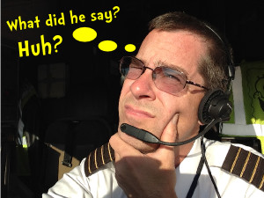
Words & Phrases to avoid
“And”
“Last call”
“Area”
“uh”, “um”, “er”, “ah”
“For” or “Fer”
“To”
“Is” or “is about to”
“Currently”
“About” or “Approximately”
“A couple”
“The active”
“Taking”
“Is on a”
“Is entering”
“Settin’ up”
“We will be”
“Is gonna be”
“We are”
“Is angling”
“Making traffic”
“Is Maneuvering for…”
“Be advised”
“Inbound for landing”
“is established on a….”
Notes:
Here is a list of words & phases, most of which should never be used. Every one of these were heard on the radio at least once in a few week time of listening to the local CTAFs.
-Last call. Seems to be spreading like a bad disease. I have never had a pilot say that hearing that was useful. Please stop saying last call. Its useless.
-The active – completely useless. Stop saying this! Which runway is that? Any runway can be used. This is a terrible phrase to use yet it is done all of the time. Please do not do this.
-Area – as in Bend area traffic. Just say Bend traffic. Using the word area provides no useful information and wastes airtime.

Slide 19

Words & Phrases to avoid
“Base to final”
“Touch & go” (or similar, when other than on final)
“Short Final” (when 1+ miles out in a slow aircraft)
“Line up and wait”
“Is clear of the active” (especially when not clear)
“Is on a left/right 45 to a left/right downwind”
“On the go”
“Taxi for the runup area”
--
Notes:
-Base to final: Pick one! You can’t be on both at the same time, plus everyone knows what leg comes after base. Saying 2 legs of the pattern is confusing. An exception might be a helicopter doing a 180 deg. engine out maneuver and the 180 deg. turn will be very rapid. Even then, its not great in my opinion
-Touch and go: Definitely call landing type other than full stop (T&G or Stop & go, but save it for the call on final (or on base if deemed necessary). Saying touch & go on the way inbound and every leg is excessive.
-Short Final: This is when inside of ½ mile final. Not when further out.
-Line up and wait: tower call. Not much benefit to sitting on runway and exposing your back-side with no view of who may be behind you. Dangerous, I recommend you do not do this. The amount of time saved is negligible, especially if you time your runway entry correctly.
-Unless the runup area is not at the end of the runway then just call out the runway going to.
-Is clear of the active, What is the “active runway”? It doesn’t exist! Is clear of runway 11, or clear of the runway is much more useful and correct.
-On a left 45 to left downwind. The 45 only goes to downwind. No one needs to be told where you are going to off of the 45! “ Bend traffic, Skyhawk 3AB, 3 mile left 45, runway 16” is a much better 45 call.
-On the go: much overused call. Rarely is this needed. Airplanes on departure leg, or in middle of a touch & go don’t need to make this call.
-Taxi to the run-up area: Non standard. Call taxing to runway XX. If taxiing to a run-up area for maintenance runs or other reasons than going flying, calling taxi to run-up area is a good idea for SA. Or if the run-up area is not at the end of the runway it might be a useful call.

Slide 20
do not…
DO NOT make calls on CTAF that you can make on an area frequency.
DO NOT say you are doing something that you are not yet doing.
DO NOT get into arguments on CTAF! Save it for the ground.
DO NOT switch to a CTAF frequency and ask for an airport advisory if you have not listened for a couple of minutes.
Notes:
-#1: Telling Bend CTAF that you are maneuvering over 4 Corners is a waste of airtime, esp. when there is a dedicated air-to-air frequency that has been established for that purpose.
-#2: Making a call such as “…Skyhawk 123 is entering left downwind runway 28” and you are still 2-3 miles out on the 45 is inaccurate and confusing, DON’T DO IT!
-#4: If the pattern is busy you will likely get all of the information you need by listening. Don’t create radio congestion unnecessarily. If there is an AWOS/ASOS at an airport there should be no need to ask for an advisory. Using the “any traffic in the area please advise” is highly discouraged by the FAA and everyone else. It makes the pilot sound ignorant and arrogant and can lead to unnecessary congestion on the frequency.

Slide 21
Commonly heard bad radio calls
Bad: “And… Bend traffic, this is, uh, Skylane 123AB at, um, about ten or fifteen miles to the, ah, west . . . no, I mean northwest. We will be entering a left 45 for left downwind to, uhh, runway 34.”
Good: “Bend traffic, Skylane 3AB, 10 west, 5,000ft, inbound.”

Slide 22
Commonly heard bad radio calls
Bad: “Bend area traffic, Cessna 123AB is on a left 45 to a left downwind to(for) three four.”
Good: “Bend traffic, Skyhawk 3AB, 3 mile left 45, runway 34, Bend”

Slide 23
Commonly heard bad radio calls
Bad: “Prineville area traffic, Cessna 12345 is taking the active for a left downwind departure, we will be heading to the North, Prineville area traffic”
Good: Prineville traffic, Skywagon 345 departing runway 11, left downwind departure northbound, Prineville.”

Slide 24
Proper sequence of calls
INBOUND EXAMPLE
Bend traffic, Skyhawk 7RL 10 East, six thousand, inbound, Bend
Bend traffic, Skyhawk 7RL crossing midfield at 5,500, westbound (or “left teardrop 16”), Bend
Bend traffic, Skyhawk 7RL, 3 mile right 45, runway 16, Bend
Bend traffic, Skyhawk 7RL turning right downwind runway 16, Bend
Bend traffic, Skyhawk 7RL turning right base 16, Bend
Bend traffic, Skyhawk 7RL turning final 16, Bend
Notes:
Here is what should be a typical sequence of calls for an aircraft inbound to a non-towered airport.
-Make calls when turning in the pattern and calling “Turning”, e.g. ..turning left base… when able is recommended in Air Safety Foundation’s safety advisor 08 and works well because others looking for you can see a turning airplane easier due to the “wing flash” of a turning aircraft.
-“runway” could be eliminated to shorten calls even more.

Slide 25
Proper sequence of calls
OUTBOUND EXAMPLE
Bend traffic, Cherokee 9YZ, SkyService, taxi to runway 16 via alpha, Bend
Bend traffic, Cherokee 9YZ, taking off runway 16, southwest departure Bend
or
Bend traffic, Cherokee 9YZ, taking off runway 16, right downwind departure northwest, Bend
Bend traffic, Cherokee 9YZ, turning right crosswind 16, Bend
(if necessary for deconfliction)
Bend traffic, Cherokee 9YZ, turning right downwind, departing northwest, Bend
Notes:
Make other calls only as necessary for deconfliction with possible threats.
-Taxi call, you could say “…Jet Center taxi 16 via alpha, Bend”.

Slide 26
Practice instrument approaches
Pilots should announce position in both IFR and VFR terms.
  “Bend traffic, Baron zero Charlie golf, HEKIL inbound, six-mile final, runway 16, Bend.
  or
  “Bend traffic, Baron zero Charlie golf, four-mile final, RNAV 16 Zulu inbound, runway 16, Bend.
Notes:
Use both IFR & VFR terms is recommended by AOPA Safety Advisor (SA08) Operations at Non-towered Airports

Slide 27
Other communications
CTAF is not to be used for long conversations, so:
Use company (Base) frequency
Use an Air-to-Air frequency
Be Courteous!
Notes:
CTAF is for traffic only (or Unicom if on same frequency). Use a different frequency for any other communications.
-AIM 4-1-11 has some air-to-air frequencies (122.75 is common)
-AC 90-50 has more frequencies
-123.25 is helicopter air-to-air

Slide 28
Teaching tips
Set a good example!
Get new Private Pilot candidates working on proper calls early
Give homework assignments on communications
  Read the AIM, Pilot/Controller Glossary and other sources of how to communicate well on the radio (See my references list).
Critique radio calls often (good & bad calls)

Slide 29
Teaching tips
Practice techniques:
  Start with learning proper communication techniques!
  Chair fly! Visualize while making calls out loud
  Make simulated radio calls while driving
  Make a “tape (or cardboard) runway” on the floor & walk the pattern
  Practice often!!
  Listen to CTAF on portable radio and critique calls
  Listen to LiveATC.net
  Other ideas?
Notes:
-Don’t parrot other pilot’s bad calls. Get in the books and learn proper radio calls.
Tape runway or make a runway with cardboard or tape & lay on the floor
-Live ATC is good for learning comms. but not necessarily non-towered comms.

Slide 30
Benefits of good radio work
You're easily understood
Radio congestion is reduced
Anyone on frequency will recognize you as a pro
Good VFR calls helps lead to good IFR calls
ATC will be prejudiced in your favor
Most importantly…Everyone will be safer!

Slide 31
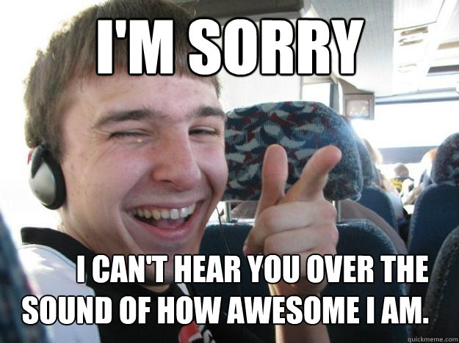
The challenge
Critique yourself after every flight. Ask, what did I say that can be removed or improved.
Group challenge. Every time an instructor/pilot gets caught making a radio call using a word or phrase on the hit list they have to put $1 in the “swear” jar.
Notes:
Be your own worst critic

Slide 32
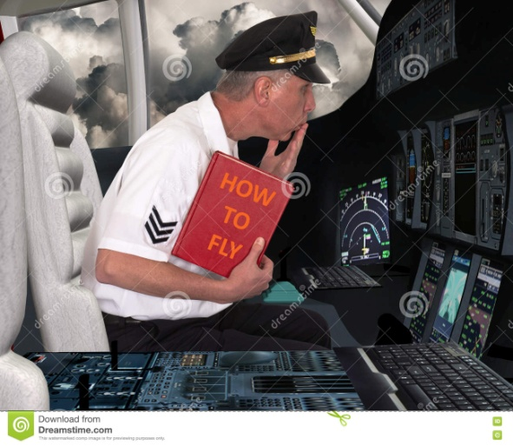
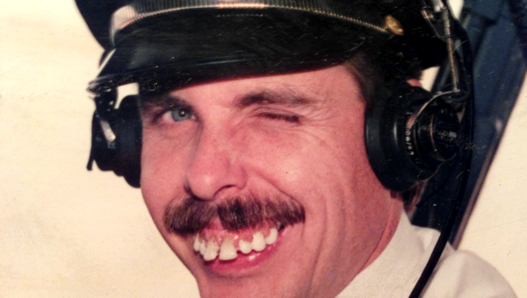
A thought
Remember that others are listening and if you use poor radio communications:
  You only create confusion and distract from situational awareness, when you should be enhancing it.

Slide 33
references
AIM 4-2
Austin’s Very Easy Guide to Proper Radio Phraseology and Technique by Austin S. Collins (2012)
AC 90-66C (6/6/23)
AOPA Safety Advisor (SA08) Operations at Non-towered Airports
Personal experience
Notes:
There is 6th edition of The Pilot’s radio Communications Handbook.

Slide 34
Contact info
Mike Kloch
(541) 728-3620
Mike@Fly-SAW.com
For links to the listed references, tips for pilot, CFIs and more, go to my webpage:
  http://mikekloch.com
  https://mikekloch.com/home/advanced-airplane-learning/references/
Constructive feedback is always welcome!

Slide 35

FAA WINGS
https://www.faasafety.gov/
FAA Wings awarded for:
Analysis of General Aviation fatal accidents & LOC
Promoting proficiency ground and flight training
Phase completion (roughly 3 hours ground & 2 to 4 hours flight) satisfies requirements for Flight Review
Shows you have an interest in safety
Notes:
THIS SLIDE:
First paragraph is animated; click to reveal second paragraph
PRESENTER:
The FAA Wings credits are awarded for attendance at Seminars conducted by FAASTeam Program Managers, Representatives and Guest Speakers. The credits are based on three levels: Basic, Advanced and Master. After completion of each phase (based on the number of credits – check the FAA Safety My Wings Website) in each level, FAA WINGS are awarded to the pilot. CFIs are authorized to validate credit for the flight and ground evaluation and testing.
NEXT SLIDE:
Red text is animated; click to reveal each summary bullet point
CLICK TO PROCEED TO NEXT SLIDE

Slide 36
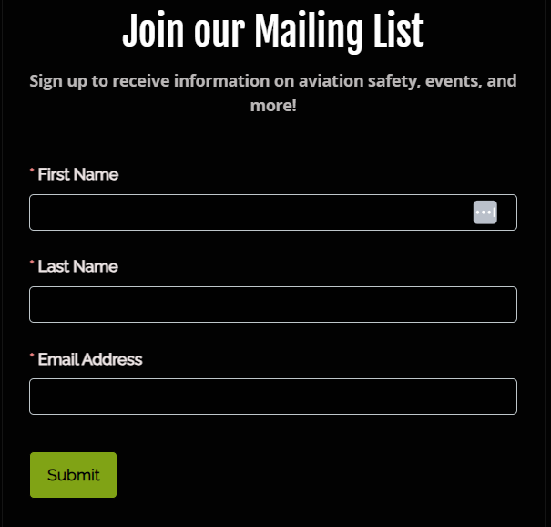

Join our mailing list
Fly-SAW.com
Go to bottom of the webpage
Notes:
Get our monthly newsletter that features safety articles, aviation news and SAW happenings

Slide 37
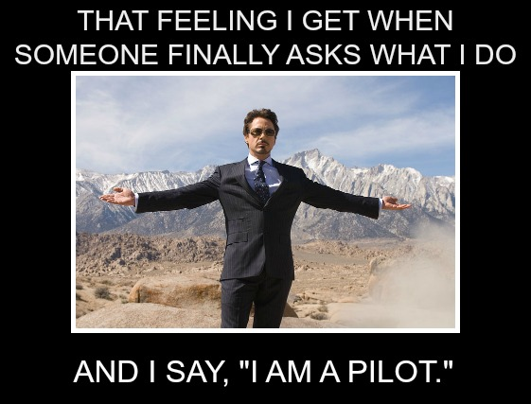
Questions?

Slide 38
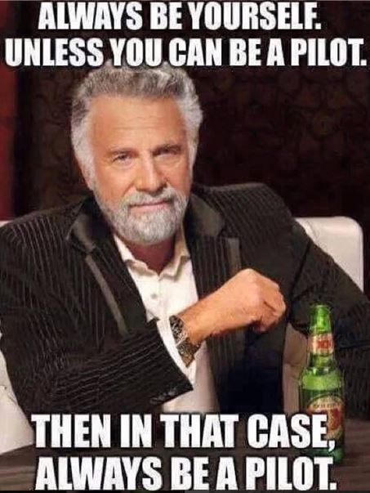
The end
Thanks for your attention & participation,
Notes:
Make sure you are or are working on being a good pilot. Part of that means excellent communications!

