Slide 1
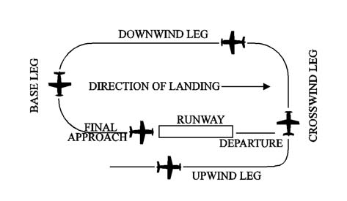

Non-Towered Airport Traffic Patterns
Notes:
This mostly applies to towered airport patterns as well.

Slide 2
Non-Towered Airport Traffic Patterns
Central Oregon Pilots
Mike Kloch
11 May 2023

Slide 3

admin
Welcome
Fire Exits
Restrooms
Phones silent please
Sponsor Acknowledgement

Slide 4
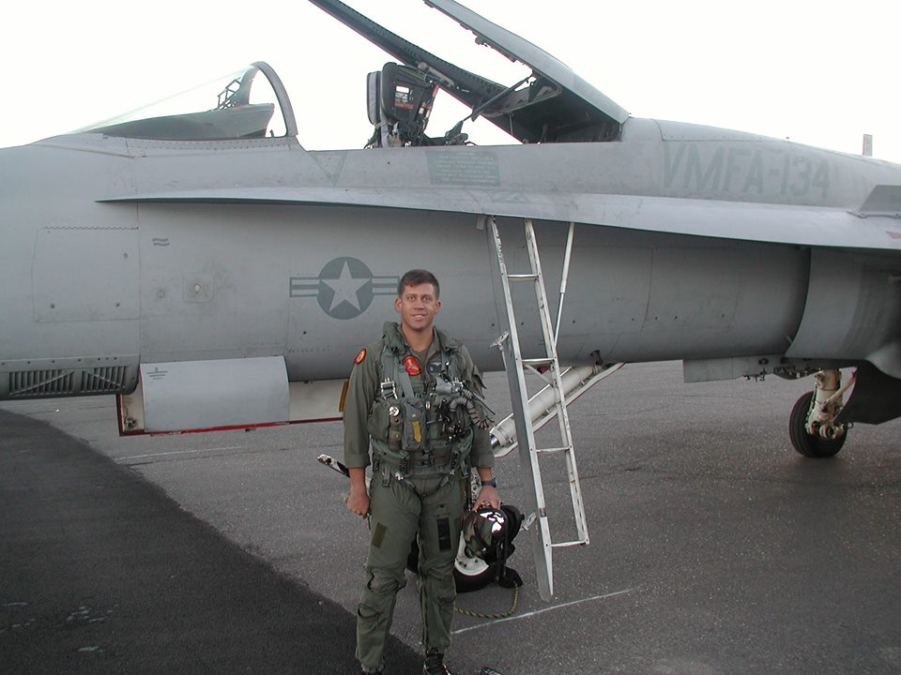
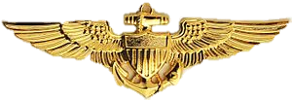

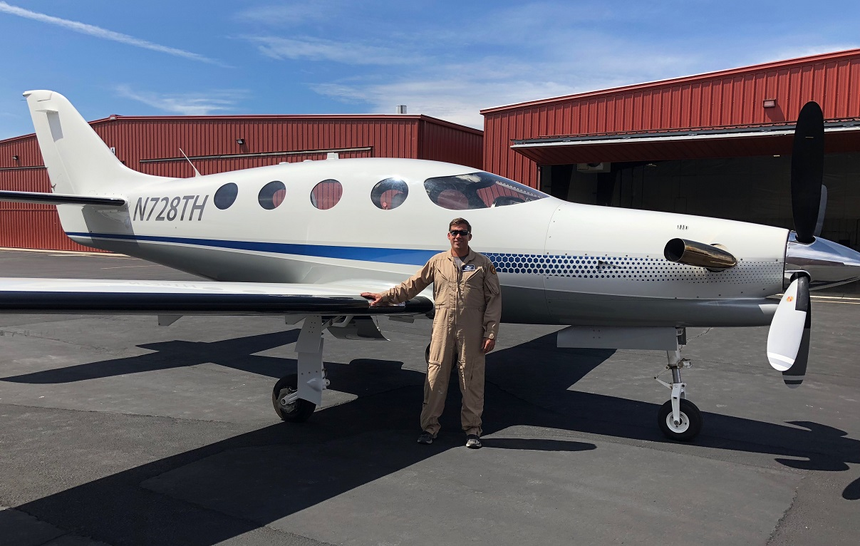
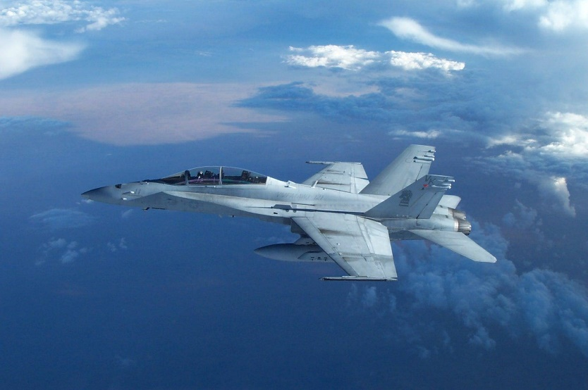
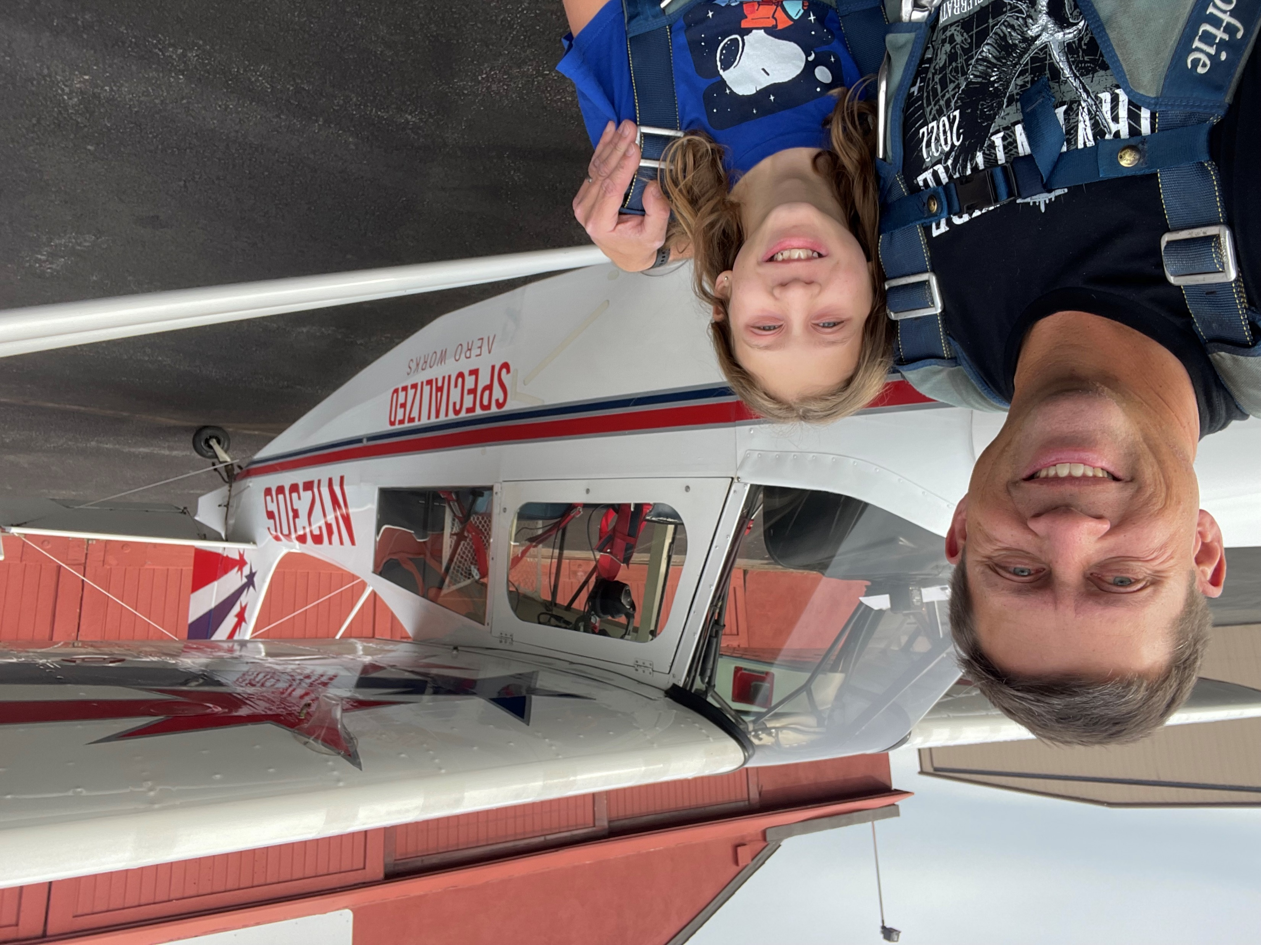
Mike “Cuckoo” Kloch
CEO/Chief Instructor Pilot for Specialized Aero Works
Master CFI - Aerobatic
2 x NAFI Master CFI; CFII, MEI
Epic Aircraft Factory Contract Test Pilot / Instructor
FAA Safety Team (FAAST) Representative
Contract pilot for Elite Pilot services (Evolution)
Former Chief Airplane instructor at Leading Edge
Former Advanced Flight Dynamics Chief Instructor Pilot
Former Air Ambulance Captain
Former Marine Corps F/A-18 pilot
School trained Aviation Safety Officer (NPS)
Former USMC Reserve F/A-18 Standardization Officer
B.S. degree from OSU, 2 Aviation Degrees from COCC
Former part-time aviation instructor at COCC
Commercial & Instrument Helicopter rated
Notes:
3500+ dual given in 36 different models of airplane

Slide 5
Why are we here?
To discuss landing patterns and non-towered airport communications.
Mastery of the fundamentals is the foundation of excellence.
Issues
Patterns are generally too big and unsafe practices are observed often.
Radio calls leave plenty of room for improvement.
These presentations review the basics, but do not cover everything. The focus is on proper, safe and efficient practices.
Notes:
Mastery of the basics is necessary for good piloting.
Someone will probably disagree. That’s ok, speak up and let’s discuss it.

Slide 6
Agenda
Why are proper patterns important
Review proper pattern terminology
Pattern entries & departures
Pattern procedures
Adjustments & spacing
Instrument Approaches
Overhead Approach Maneuver
Run-up area etiquette
Benefits
Notes:
There will be more than one disagreement with something I say. Please speak up with them so we can discuss.

Slide 7
Airport traffic patterns
  “It is imperative that pilots are taught correct traffic pattern procedures and exercise constant vigilance in the vicinity of airports when entering and exiting the traffic pattern.”
  AFH
  “Regardless of the type of airport, a pilot must know and abide by the rules and general operating procedures applicable to the airport being used. The objective is to keep air traffic moving with maximum safety and efficiency.“
  AFH
  Proper patterns are imperative for safety!
AFH = Airplane Flying Handbook
Notes:
-Proper patterns are important for safety AND efficiency!
-Everyone needs to know the purpose of patterns and be taught to fly them correctly. Unfortunately this is something that has degraded over the years as we can regularly see anything from small annoyances to serious buffoonery in the local airport traffic patterns. This problem is not limited to Central Oregon only though. Bob Meder, National Association of Flight Instructors (NAFI) Board Chair recently wrote about poor airport procedures at an airport local to him.
-With the skies of Central Oregon rapidly becoming more and more crowded we need to remedy the problem of poor pattern work!

Slide 8
Regulations
91.126 Operating on or in the vicinity of an airport in Class G airspace.
91.127 Operating on or in the vicinity of an airport in Class E airspace.
91.111 Operating near other aircraft.
91.113 Right-of-way rules: Except water operations
What do they say?

Slide 9
Simply SAID the regulations are:
Make left turns unless published for right.
Helicopters must avoid fixed wing pattern.
Aircraft in traffic pattern have Right of Way over aircraft not in the pattern.
Don’t overtake aircraft in the pattern or fly close.
BE NICE! Don’t cut off aircraft in front or take advantage of “Lower”, or force aircraft off runway that just landed.

Slide 10
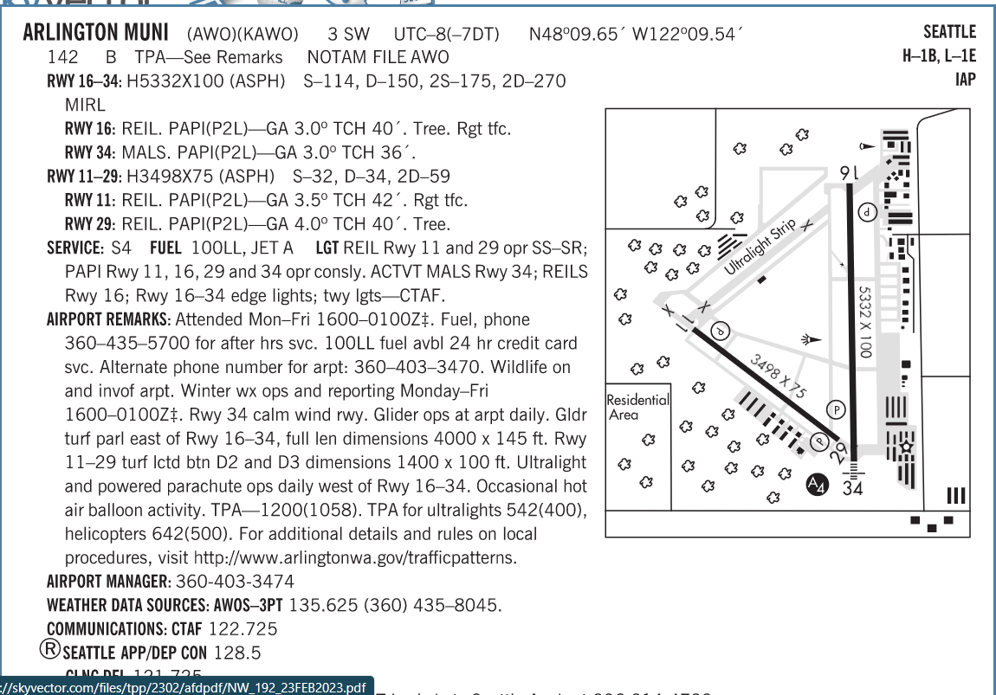
Chart Supplement graphic depictions
Notes:
The Chart Supplement sometimes points to airport websites. Be sure to check those on preflight.

Slide 11
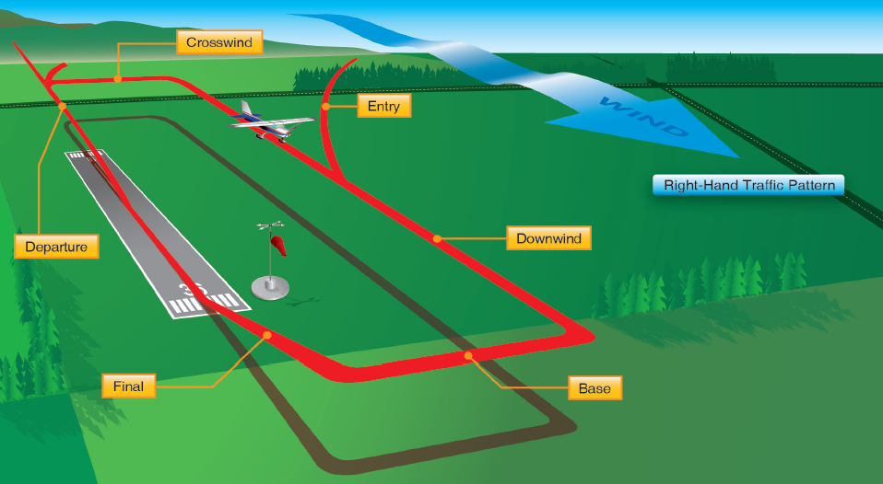
The Pattern
Airplane Flying Handbook, Chapter 8 Introduction
“Airport traffic patterns ensure that air traffic moves into and out of an airport safely. The direction and placement of the pattern, the altitude at which it is to be flown, and the procedures for entering and exiting the pattern may depend on local conditions.”
Best practices from PHAK and AFH
PHAK = Pilot’s Handbook of Aeronautical Knowledge

Slide 12
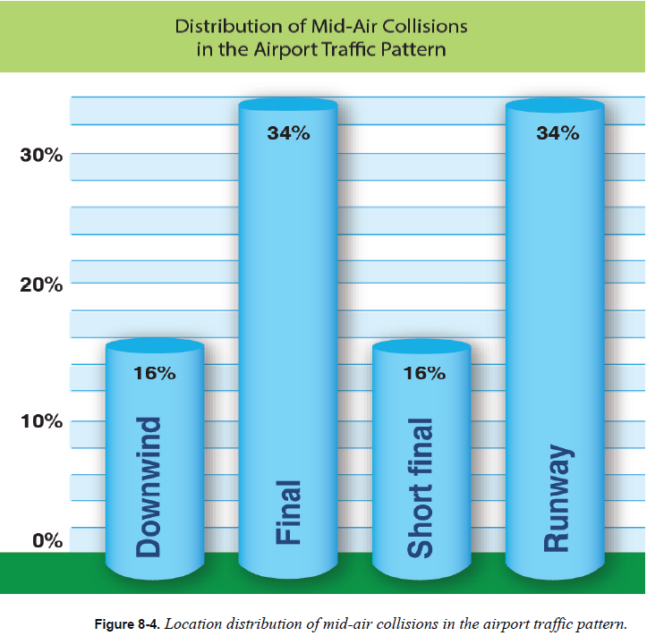
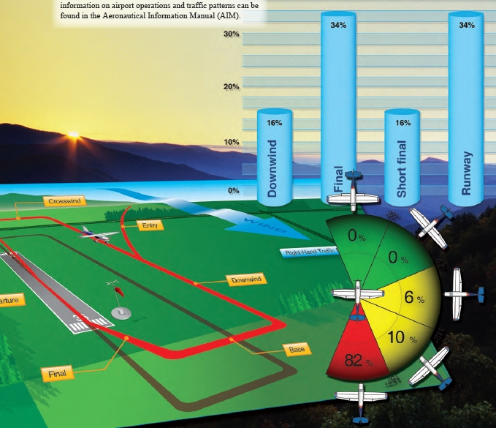
safety
Midair collisions are the primary hazard associated with flying at nontowered airports.
  Most midair collisions occur in clear weather within
  five miles of an airport and below 3,000 ft AGL, which
  is where aircraft congregate.
  56 percent occur in the afternoon, 32 percent occur
  in the morning, and 2 percent occur at night, dusk,
  or dawn.
Notes:
Graphic is distribution of mid-air collisions in the pattern.

Slide 13
Question: is there an “active” runway
Landing and takeoff should be accomplished on the operating runway most nearly aligned into the wind.
Pilots are expected to observe other aircraft already in the pattern and to conform to the traffic pattern in use.
AC90-66B, 10.7 Disagreements. An aircraft might be using a runway different from the one favoring the prevailing winds. In this case, one option is to simply point out the current winds to the other pilots and indicate which runway you plan on using because of the current meteorological conditions.
Notes:
Don’t get into arguments while in the air. Save it for the ground.

Slide 14
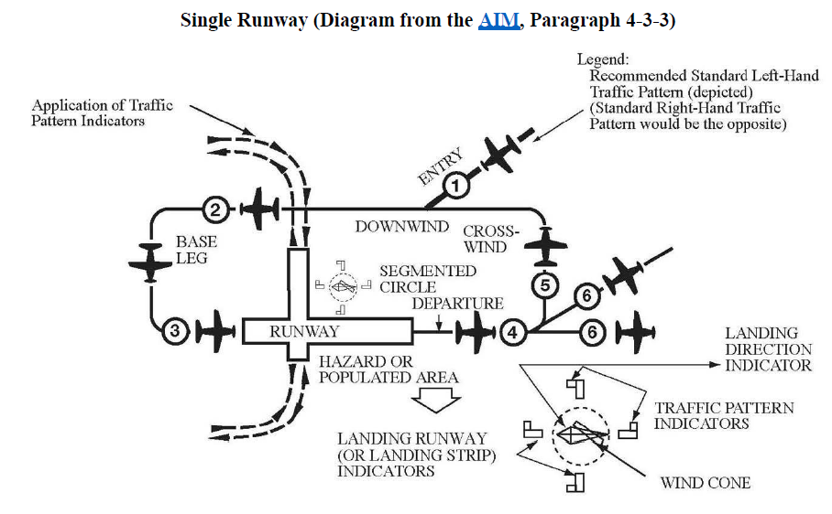
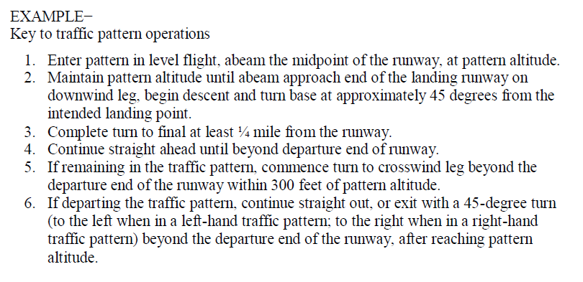
Entry and exit
Enter in level flight, at TPA
On a 45 degree to mid-field downwind
The Notes provide a lot of good info

Slide 15
Standard Pattern entry
16
34
Where does the 45 go to exactly?
When approaching an airport for landing, the traffic pattern is normally entered at a 45° angle to the downwind leg, headed toward a point abeam the midpoint of the runway to be used for landing. AFH
Correct 45 at TPA
Poor 45
Dangerous 45
Notes:
-Pointing to midfield does not get one to midfield on downwind!
-A 45 should also be approximately 45 degrees, not 30 or 60 or 90! These poorly angled 45s are seen regularly at Bend. They are unsafe.

Slide 16

The pattern
Upwind Leg
Final
16
34
Departure Leg
Base Leg
Crosswind Leg
Downwind Leg
The pilot should ensure that the entry leg is of sufficient length to provide a clear view of the entire traffic pattern and to allow adequate time for planning the intended path in the pattern and the landing approach.
45
This is NOT a 45!
Notes:
What is the definition of the upwind leg? Why does nearly everyone say “upwind” when on departure?
-This is a problem that comes from CFIs using incorrect terminology. This needs to stop!
See AIM 4-3-1
Upwind leg. A flight path parallel to the landing runway in the direction of landing. Usually on the opposite side of the pattern.
-Should we fly upwind to the East side of runway at Bend? It depends. Consider helicopter traffic on the Bravo taxiway.
6. Departure leg. The flight path which begins after takeoff and continues straight ahead along the extended runway centerline. The departure climb continues until reaching a point at least 1/2 mile beyond the departure end of the runway and within 300 feet of the traffic pattern altitude.
-

Slide 17

Standard pattern entry
Final
Departure Leg
16
34
Base Leg
Crosswind Leg
Downwind Leg
The pilot should ensure that the entry leg is of sufficient length to provide a clear view of the entire traffic pattern and to allow adequate time for planning the intended path in the pattern and the landing approach.
45
Notes:
-Where do we make a standard pattern entry?
-Where does the 45 go to? Where exactly on downwind?
-Aircraft should be at pattern altitude by 3 miles from airport, with landing light on.
-Pilots should expect all similar aircraft in the pattern, including those entering on the 45, at the same altitude so that it is easier to spot all traffic in the pattern. A midfield crossing direct downwind pattern entry should not be used when the pattern is congested.

Slide 18
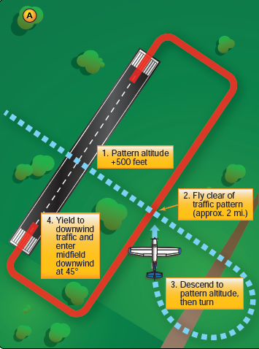
Opposite side entries
Cross midfield at least 500 to 1,000 ft. above
pattern
Call crossing midfield (as necessary)
Teardrop entry to the “45”
Notes:
1,000 ft. recommended at Bend due to large number of turbine operations.
Entry to the downwind leg should be at a 45-degree angle abeam the midpoint of the runway to be used for landing. The pilot may use discretion, however, to use an alternate type of entry based upon the traffic present and communication at the time of arrival, particularly when intending to cross over midfield. (AC 90-66B).

Slide 19
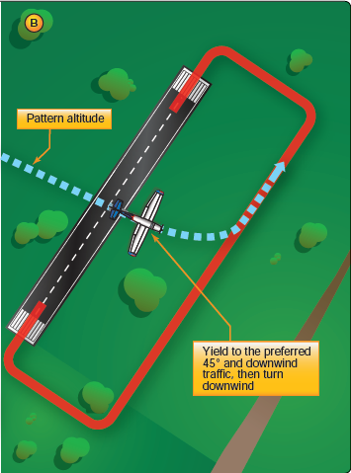
Alternate entry
Cross midfield at pattern altitude
Turn to downwind
Only use if pattern is not busy
Do not teach to Private Pilot candidates
is recommended

Slide 20
departures
Turn away from pattern
(Pattern Alt.+500 ft.)
Straight out
16
34
45 deg turn towards pattern
Downwind departure
Notes:
Discuss each departure type
-Exercise extreme caution if climbing on downwind to depart pattern. Watch for traffic crossing airport.
-If you will be departing against the flow of the pattern, wait until you are at least at pattern altitude plus 500 feet before making a turn, and be sure to advise on the CTAF. (AOPA SA08)

Slide 21
procedures
At what altitude from departure leg do you start turn to crosswind?
Start turn at 300’ prior to pattern alt, maybe make turning crosswind call (if necessary)
Final, complete flaps config, check gear, prop Hi RPM. Continuous scan: “Airspeed, glideslope, lineup”
What is the proper distance abeam the runway on downwind?
16
34
On base, add 1 notch flaps, check approach path. Call turning final, assess altitude
Crosswind: Look for traffic, make turning downwind call
Abeam 1/3 - <1 mile
Abeam the numbers, reduce power , airspeed check, 1 notch flaps, slightly lower nose for proper airspeed
Midfield, gear down (if appropriate), state “3 green”
At pattern altitude, reduce power, look for traffic, begin checklist, CGUMPS, or as appropriate
At the 45, make turning base call. Assess altitude
Airspeed on downwind?
Notes:
-Some of the procedures here may be different for your aircraft, so adjust as necessary.
-Beware of drifting laterally on departure. This is a common problem.
-After abeam distance is shown, pull up Google map
-View Google maps and show 1.12 miles abeam and 3000 ft abeam.
-How do you judge proper distance abeam? How in a high-wing aircraft such as a 172?
-Small airplanes should be close to ½ mile while larger, faster airplanes will be up to 1 mile.
-Pattern altitude is maintained until at least abeam the approach end of the landing runway. At this point, the pilot should reduce power and begin a descent. The pilot should continue the downwind leg past a point abeam the approach end of the runway to a point approximately 45° from the approach end of the runway, and make a medium bank turn onto the base leg. Pilots should consider tailwinds and not descend too much on the downwind, so as to have a very low base leg altitude. (AFH)
-Adjust power on the downwind leg, or sooner, to fit into the flow of traffic. Avoid flying too fast or too slow. Speeds recommended by the airplane manufacturer should be used.
They will generally fall between 70 to 80 knots for fixed-gear singles, and 80 to 90 knots for high-performance retractable. (AFH)
-What is the proper length of a final leg? A: ½ to ¾ mile for small airplanes. (ASF)
-If on final over the south pond you are 1.3ish NM from the end of the runway. If ground speed is 60 knots then it will take approximately 1 min 20 seconds to reach the end of runway 16! Who needs that much time on final?!? (A: No one should)

Slide 22
procedures
At what altitude from departure leg do you start turn to crosswind?
Start turn at 300’ prior to pattern alt, maybe make turning crosswind call (if necessary)
Final, complete flaps config, check gear, prop Hi RPM. Continuous scan: “Airspeed, glideslope, lineup”
What is the proper distance abeam the runway on downwind?
16
34
On base, check approach path. Call turning final, assess altitude
Crosswind: Look for traffic, make turning downwind call
Abeam 1/3 - <1 mile
NLT the 45, make turning base call. Assess altitude
Airspeed on downwind?
Notes:
-Some of the procedures here may be different for your aircraft, so adjust as necessary.
-Beware of drifting laterally on departure. This is a common problem.
-After abeam distance is shown, pull up Google map
-View Google maps and show 1.12 miles abeam and 3000 ft abeam.
-How do you judge proper distance abeam? How in a high-wing aircraft such as a 172?
-Small airplanes should be close to ½ mile while larger, faster airplanes will be up to 1 mile.
-Pattern altitude is maintained until at least abeam the approach end of the landing runway. At this point, the pilot should reduce power and begin a descent. The pilot should continue the downwind leg past a point abeam the approach end of the runway to a point approximately 45° from the approach end of the runway, and make a medium bank turn onto the base leg. Pilots should consider tailwinds and not descend too much on the downwind, so as to have a very low base leg altitude. (AFH)
-Adjust power on the downwind leg, or sooner, to fit into the flow of traffic. Avoid flying too fast or too slow. Speeds recommended by the airplane manufacturer should be used.
They will generally fall between 70 to 80 knots for fixed-gear singles, and 80 to 90 knots for high-performance retractable. (AFH)
-What is the proper length of a final leg? A: ½ to ¾ mile for small airplanes. (ASF)
-If on final over the south pond you are 1.3ish NM from the end of the runway. If ground speed is 60 knots then it will take approximately 1 min 20 seconds to reach the end of runway 16! Who needs that much time on final?!? (A: No one should)

Slide 23
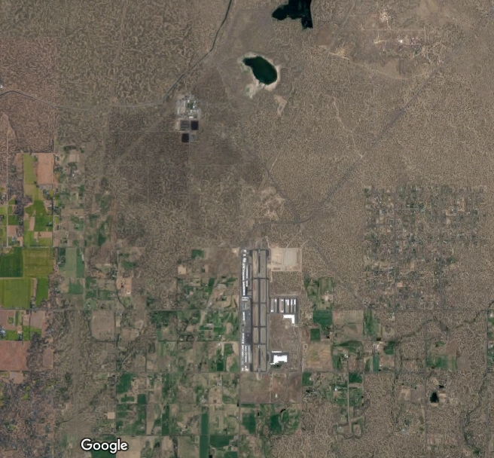
1.3 NM!
1 NM
1/2 NM
1.3 NM
1 NM
1/2 NM

Slide 24
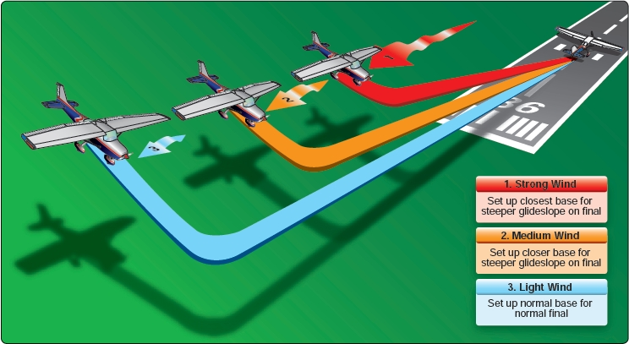
Adjustments & spacing
Correct for the wind on EVERY leg!!
Notes:
-Wind corrections need to be made on EVERY leg. Departure leg, avoid drifting off of runway centerline. Downwind, be sure to track parallel to runway. Base, turn past perpendicular (especially in stiff wind) so you don’t get pushed farther out from runway (very common). On final start slipping so you can track down extended centerline with longitudinal axis of airplane lined up with runway.

Slide 25
Adjustments & spacing
If there is an airplane on final, when do you turn to base?
What is the minimum spacing between aircraft for landing?
Minimum spacing for takeoff?
Notes:
-Turn to base = after airplane passes wing line if similar speed, just before the airplane reaches wing line if it is faster.
-Minimum spacing is 3,000 ft. (Category I aircraft landing behind Category I or II− 3,000 feet.) per FAA JO Order 7110.65W, Air Traffic Control pg. 160. So if a runway is long enough and a tower controller can have 2 aircraft on the same runway why would a non-towered runway have to be clear? Always be conservative in your distance estimates. Be extra safe if landing on an occupied runway.
-Separate a departing aircraft from a preceding departing or arriving aircraft using the same runway by ensuring that it does not begin takeoff roll until:
a. The other aircraft has departed and crossed the runway end or turned to avert any conflict. (See FIG 3−9−1.) If you can determine distances by reference to suitable landmarks, the other aircraft needs only be airborne if the following minimum distance exists between aircraft: (See FIG 3−9−2.)
1. When only Category I aircraft are involved−3,000 feet.
2. When a Category I aircraft is preceded by a Category II aircraft− 3,000 feet.
-Discuss timing for takeoffs
-These distances are used by tower controllers so they can provide a good reference for safety margins to use when arriving/departing from non-towered airports. They tendency is to use excessive spacing between aircraft which creates inefficiency. Don’t forget to consider wake turbulence.

Slide 26
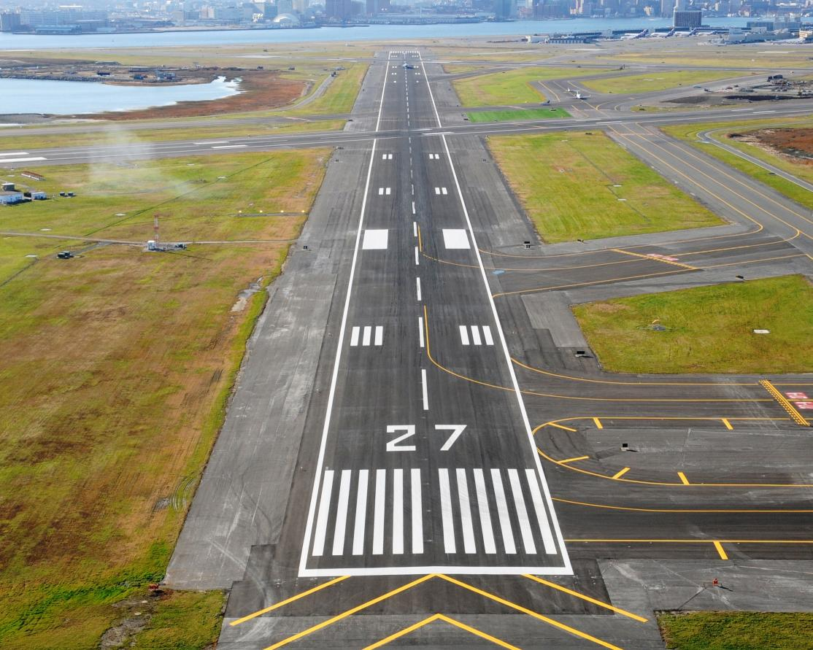
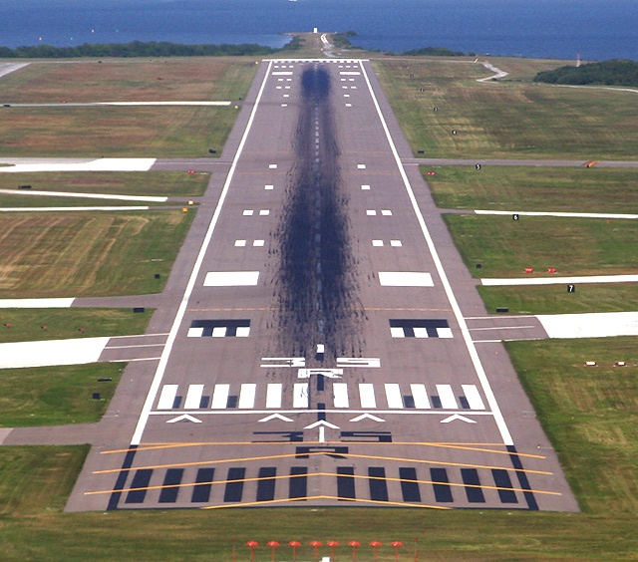
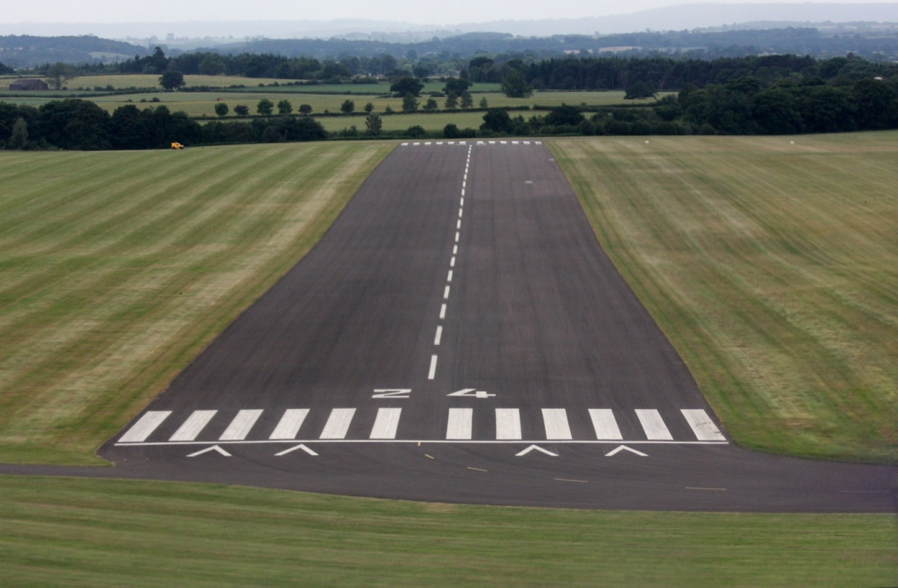
Lineup on final
Notes:
What is the centerline alignment of the viewpoint to runway centerline for each picture?
How do you determine runway alignment once on final? A: Scan up & down the entire runway and look for alignment with centerline & runway edges can help with the big picture also.
-MANY pilots have the bad habit of only looking at the approach end of the runway. They do not see that they are off of centerline until very close to the runway.
-When should you determine your extended runway centerline alignment? A: while turning from base to final!
--Which picture are you seeing the most often? Left, Center, or Right alignment?
-If you or a PT keeps repeating the same over/under-shoot when do you interject?
-What approach speed are you using? What is correct? A: Published approach speed or 1.3 Vs (C172 Vs is 47 then approach is 61 knots (50 kt Vs=65kts))
-Does anyone call out “pitch for airspeed, power for altitude”? PTs easily forget (or don’t know) about the backside of the power curve, which you are very close to.
-Who is flying all the way down final on the PAPI glideslope on VFR flights? Can you make it to the runway if the engine dies? Not if on a long final.
-Which section of the runway should you land on? A: first 1/3 or runway. Then why are airplanes sometimes landing well beyond the midpoint of they runway!?! This should not happen. It is not ok. Go around!
-A lot of floating down the runway is commonly seen. Use the correct approach speed & pull power once runway is made (Cessna's & similar only, not Beech aircraft or others where this is not appropriate) or at proper time.
-Extra speed in close is not good. Fast is as, or more dangerous than being a little slow.

Slide 27
What word describes doing the same thing over and over again and expecting different results?
INSANITY!
Notes:
This applies because, if you care, watching someone continuously overshoot the turn to final will drive you crazy! If you are the one who continually makes the same mistakes it is time to fix the problem. Use bracketing.

Slide 28
Instrument approaches
Exercise vigilance to see and avoid traffic
If there is heavy VFR traffic and you’re on an instrument approach to other than the runway in use, break off the approach before a conflict develops and enter normal traffic. Announce your intentions on the CTAF.
If another aircraft is on a straight-in instrument approach in visual conditions and it will not greatly inconvenience you, consider extending your downwind to follow the aircraft. Be sure to announce your intentions.
Be extra cautious if you are in the pattern with a low ceiling. Watch & listen for aircraft coming in on approaches and breaking out without much time to see traffic.

Slide 29
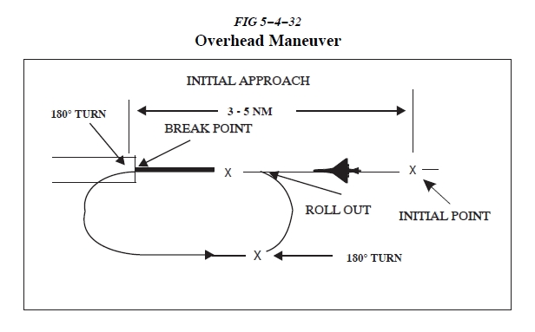
Overhead approach maneuver
AIM 5-4-27
Notes:
-Who knows what an overhead approach maneuver is, also known as “the overhead”? These are good to understand so you will know what to expect if an airplane, or flight of airplanes, come in for the overhead.
-The overhead is commonly used by fast military aircraft, warbirds and others. The primary purpose is to facilitate the recovery of a large number of aircraft in a minimum amount of time…utilizing less airspace.
-The initial is 3-5 miles from end of approach runway.
Don’t forget to think about what could be called careless and reckless by the FAA (91.13)

Slide 30
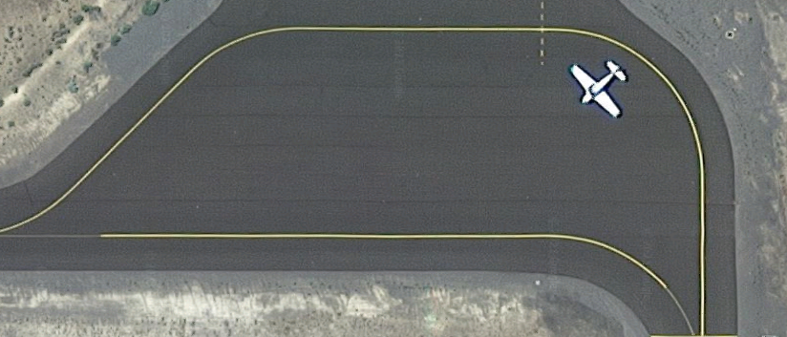



Runup area etiquette
No!
Yes!!
No!
No!
No!
No!
Notes:
-Be considerate and make room for others. Don’t park in the middle of the runup area as if you are the only one flying
-Don’t waste space
-You do not need to point directly into the wind. What modern airplane has overheating issues if not pointed directly into the wind?

Slide 31
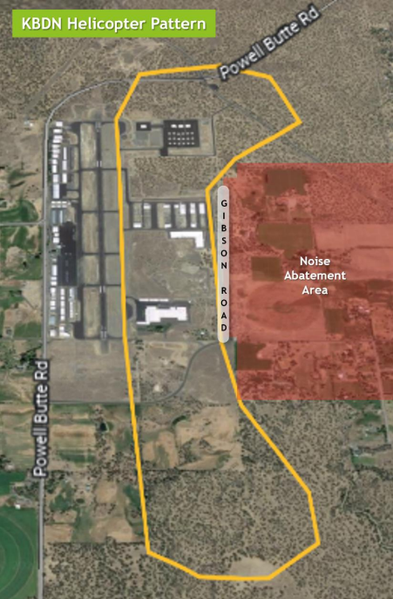
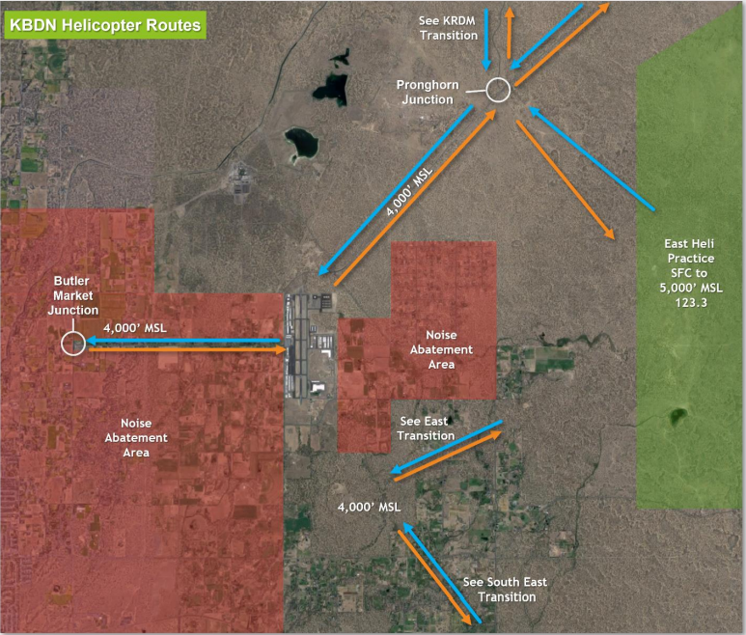
BDN Helo ops

Slide 32
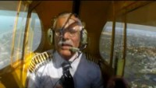
A Sarcastic View of Pattern flying

Slide 33
Tips for teaching patterns
Remember Primacy!!!
  Primacy, the state of being first, often creates a strong, almost unshakable impression and underlies the reason an instructor must teach correctly the first time and the student must learn correctly the first time. For example, a maintenance student learns a faulty riveting technique. Now the instructor must correct the bad habit and reteach the correct technique. Relearning is more difficult than initial learning.
  -Aviation Instructor’s Handbook
Make Pilots in Training (PTs) study the AFH and other materials early in training
Read Safety Advisor 08 (SA-08) from the Air Safety Institute
Give a thorough ground lesson on landings before teaching in the air
Require PTs to be able to verbalize pattern procedures before flying
Notes:
Primacy is real. You have to teach pilots in training how to do it correctly from the beginning.

Slide 34
Tips for teaching patterns
Chair fly
Demonstrate an excellent pattern from time-to-time
Set high standards and enforce them
Tips from the crowd?
Notes:
There are many ways to chair fly. Discuss using tape or cardboard runway on floor technique.

Slide 35
Do
Whenever you're flying and considering doing something the least bit risky or non-standard, think about how it would read in an accident report
Don’t forget about FAR 91.13, the FAAs catch-all, careless and reckless operation
Be predictable
There is much to be gained and nothing to be lost in flying and teaching proper patterns

Slide 36
benefits
Some benefits of proper patterns include:
  Predictability (safety),
  Ability to reach runway with engine failure (safety),
  Easier to be seen
  Fewer birds,
  More engine out landing options,
  Fewer obstacles,
  Consistency,
  Safety,
  Efficiency and discipline
BE COURTEOUS
Any other thoughts I missed?
Is there anyone who disagrees?

Slide 37
Things to remember
Tight patterns are GOOD!
Always work on improving your skills

Slide 38



Negative motivation
An unwillingness to teach or fly proper patterns
may be due to:
Laziness
Signs of a weak instructor or poor technique
Bad attitude
Lack of adequate knowledge
--

Slide 39
References
Airplane Flying Handbook, 2021 (FAA-H-8080-3C)
AC 90-66B Non-Towered Airport Flight Operations
SA-08 Operations at Non-Towered Airports (AOPA)
Pilot’s Handbook of Aeronautical Knowledge (PHAK) 2016 (FAA-H-8080-25B)
Airman’s Information Manual (AIM)
Rod Machado’s How to Fly an Airplane Handbook
FAA JO Order 7110.65W, Air Traffic Control
A sarcastic View of Pattern Flying (https://youtu.be/f6q2VKsvQEQ)

Slide 40
Contact info
Mike Kloch
(541) 848-7790
Cuckoo@mikekloch.com
For links to the listed references, tips for CFIs and more, go to my webpage:
  www.mikekloch.com

Slide 41
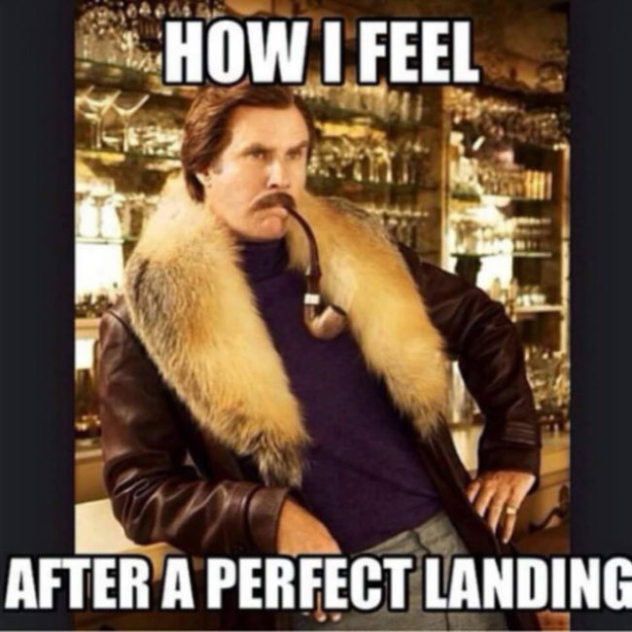
Questions ?

Slide 42
THE END

